Slide 1
Medical Expense Prediction
Brenden Hale

Slide 2

Business Problem
To foster a dynamic pricing model and a greater competitive advantage, we need a method to accurately predict our customers medical expenses based on their individual profiles

Slide 3
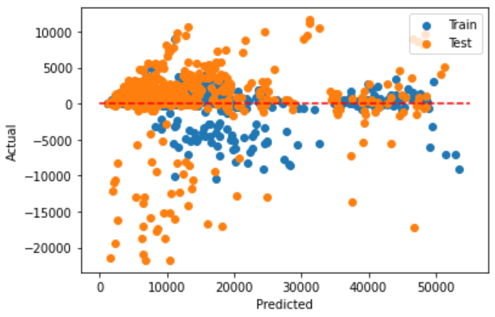
Solution
Create a linear regression model using machine learning
Feed customer profile to model for prediction
Model will return an approximation of medical expenses per calendar year
Create or adjust premium based on findings

Slide 4
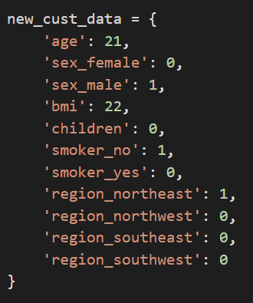
Results
Given a new customer with the attributes: 21 years old Male Bmi equals 22 Non-smoker Lives in the northeast region of the US
The model estimates this person will have incurred $651.00 in medical expenses for the year
The model is flexible and can be tailored to the business needs by putting a greater emphasis on attributes such as age or obesity (bmi) or by enhancing the dataset

